Slide 1


DATABASE MANAGEMENT SYSTEM • CAPSTONE PROJECT
Cloud Kitchen & Food Delivery
Management System
A MySQL Relational Database with an Interactive Analytics Dashboard
Python
MySQL
Streamlit
Plotly
PRESENTED BY
ORGANIZATION
PROJECT GUIDE
Aakash Nath
Abhijit Roy
Anudip Foundation
Centre of Excellence
Mr. Amitava Chatterjee
Notes:
1

Slide 2




WHY THIS PROJECT MATTERS
Problem Statement
Data Falls Out of Sync
Manual Rating Recalculation
Order status and delivery status drift apart without automation.
Recomputing ratings in app code risks slow, inconsistent results.
No Live Operational Reports
Referential Integrity Risk
Today's orders and pending deliveries need repeated complex joins.
Eleven linked entities are hard to keep consistent without constraints.
Notes:
2

Slide 3






WHAT THIS PROJECT SET OUT TO ACHIEVE
Project Objectives
Normalized 11-Table Schema
Enforce Data Integrity
Automate Rating Updates
Design a fully relational cloud kitchen data model.
Primary keys, foreign keys and CHECK constraints.
MySQL triggers update ratings without app logic.
Build a Reporting Layer
Realistic Sample Data
Migrate SQLite to MySQL
SQL Views for orders, top restaurants, deliveries.
Faker library generates lifelike demo records.
Resolve real dialect and syntax differences.
Notes:
3

Slide 4

TOOLS POWERING THE PLATFORM
Technology Stack
Python
MySQL 8.0+
Streamlit
Plotly
Core programming language connecting every layer.
Relational engine with triggers, views and constraints.
Interactive eight-page web dashboard, zero HTML.
Interactive charts for KPIs and business trends.
04
Notes:
4

Slide 5



LAYERED REQUEST AND DATA FLOW
System Architecture
User
Interacts through the browser-based dashboard
Streamlit Application
Renders pages, charts and the SQL console
MySQL Database
Applies constraints, triggers and views
Dashboard Visualization
Displays KPIs, tables and Plotly charts
Notes:
5

Slide 6

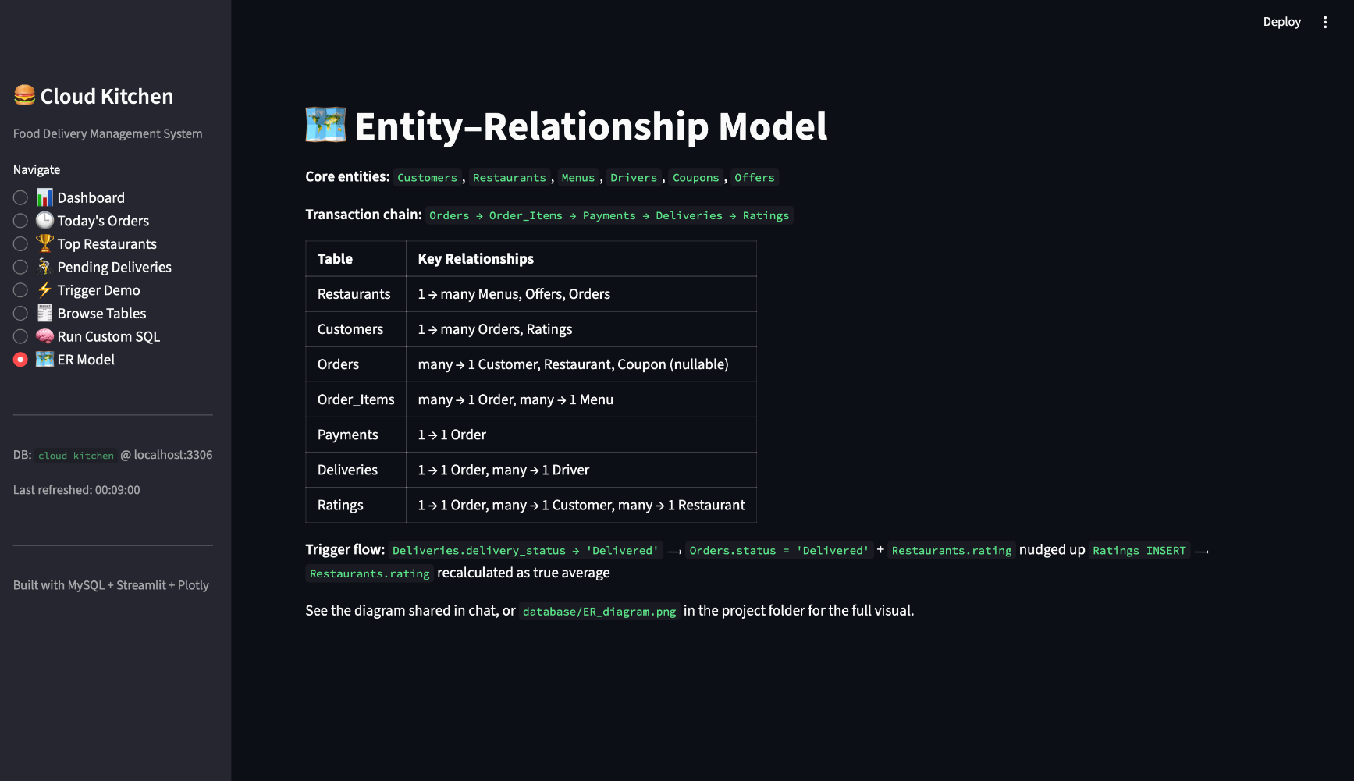



ELEVEN-TABLE NORMALIZED SCHEMA (3NF)
Database Design
Primary Keys
Every table uses an auto-increment identity column.
Foreign Keys
ON DELETE CASCADE keeps related records consistent.
Normalization
Schema follows third normal form throughout.
Relationships
One-to-one, one-to-many and junction tables.
Notes:
6

Slide 7





CORE CONCEPTS DEMONSTRATED IN THE SCHEMA
Key SQL Features
DDL
DML
DQL
CREATE TABLE, TRIGGER and VIEW
INSERT, UPDATE and TRUNCATE
SELECT with WHERE and GROUP BY
Views
Triggers
Joins
Reusable reporting queries
Automated rating business rules
INNER and LEFT JOIN across tables
Notes:
7

Slide 8
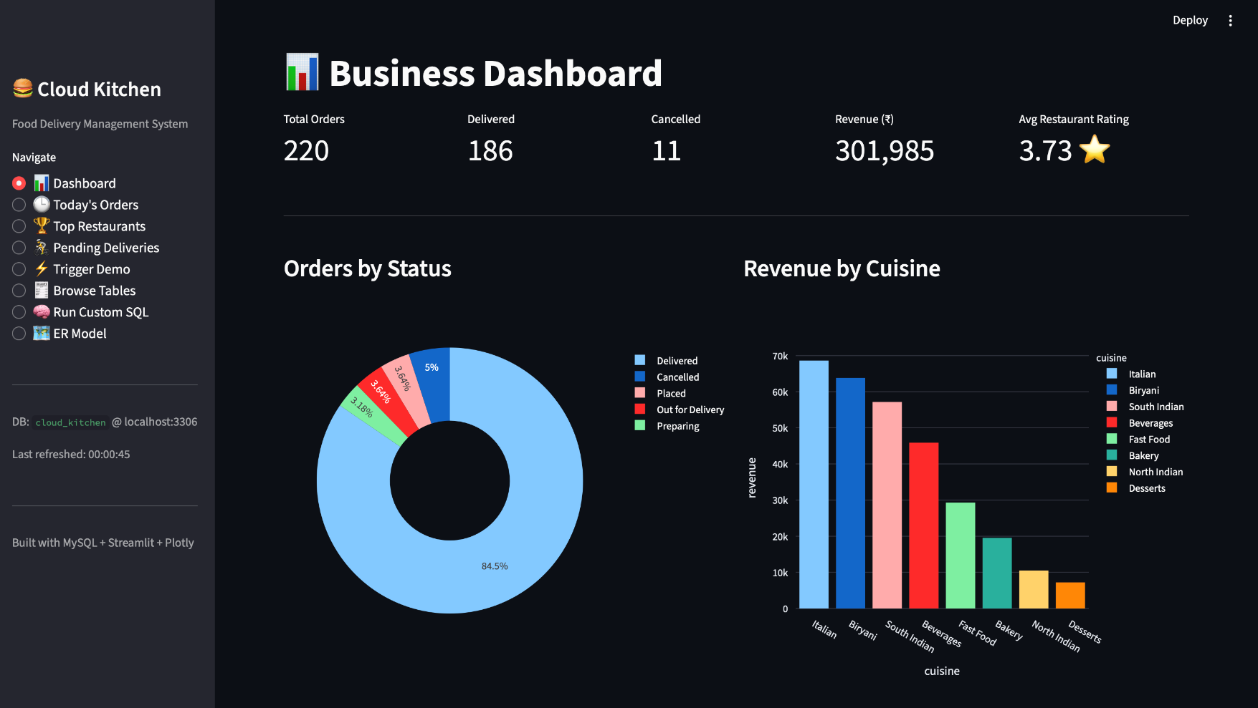


LIVE ANALYTICS FOR BUSINESS STAKEHOLDERS
Dashboard Overview
An eight-page Streamlit application gives stakeholders a live, visual window into the database.
KPI Cards
Orders, revenue and average rating
Interactive Charts
Trends, cuisine and payment splits
Live Data Views
Reporting views rendered in real time
Notes:
8

Slide 9





WHAT THE DATA REVEALS TO OPERATORS
Business Insights
Order Trends
Restaurant Performance
Revenue Analysis
Ratings
Delivery Monitoring
30-day order volume trend line
Ranked by rating and order count
Revenue broken down by cuisine
Automated trigger-based recalculation
Live pending-delivery tracking
Notes:
9

Slide 10


HIGHLIGHTS OF THE PLATFORM
Key Features
Executive KPI Dashboard
Trigger-Based Automation
Reusable Reporting Views
Instant snapshot of platform health
Ratings update without app code
Three SQL views power live pages
Safe SQL Console
Raw Table Browser
In-App ER Model
SELECT-only ad-hoc query access
Inspect all eleven tables directly
Schema and trigger flow explained
Notes:
10

Slide 11


WHERE THE PROJECT STANDS, AND WHAT'S NEXT
Advantages & Future Scope
Advantages
Future Scope
Fully normalized schema with referential integrity
Role-based login for customers and restaurants
Rating logic automated entirely via triggers
Driver mobile app with live GPS tracking
Reusable SQL Views decoupled from app code
Real payment gateway integration
Real-time dashboard for non-technical users
AI-based menu recommendation engine
Safe, read-only ad-hoc SQL console
Cloud deployment on managed MySQL
Notes:
11

Slide 12
SUMMARY OF PROJECT OUTCOMES
Conclusion
Eleven-table schema models a full delivery lifecycle
CHECK constraints and foreign keys enforce integrity
Two chained triggers automate rating updates
Three SQL Views power live reporting pages
Streamlit dashboard delivers real-time business intelligence
SQLite-to-MySQL migration adds real engineering depth
Notes:
12

Slide 13

Thank You
Questions?
Cloud Kitchen & Food Delivery Management System
Python • MySQL • Streamlit • Plotly
Notes:
13

